Slide 1
Block Chain Technologies Presentation
Alt Coins – Squid Game Coin
By: Dennis Churchill J - 2020178011
Ebenezer Isaac Veeraraju - 202017014

Slide 2
What is a liquidity pool?
A liquidity pool is a crowdsourced pool of cryptocurrencies or tokens locked in a smart contract that is used to facilitate trades between the assets on a decentralized exchange (DEX).
Instead of traditional markets of buyers and sellers, many decentralized finance (DeFi) platforms use automated market makers (AMMs), which allow digital assets to be traded in an automatic and permissionless manner through the use of liquidity pools.

Slide 3
How did the scam work
The developers took advantage of the liquidity pool that exists between the Squid tokens issued and BNB tokens issued by Binance while holding majority of the supply.
It allowed them to transfer the value of the Squid Games coins into BNB tokens, which they then stole away.
The theft is public, but the scammers used a mixing and tumbling service called Tornado Cash to try to obscure their tracks.

Slide 4
Why was Squid Game Coin scam so widespread?
Media coverage failed to point out that there was no official tie-in with the Netflix series
Eye-boggling increase in price
The background of the Netflix show.

Slide 5
Technical Details
26th Oct 2021 – less than $1
1st Nov 2021 - 10:30 am - $381
1st Nov 2021 - 01:30 pm - $28611
1st Nov 2021 - 02:30 pm - $0.003
Current Price - $0.04

Slide 6
The future of Squid Game
The developers addresses were blacklisted and Binance announced a pending investigation into the developers.
Squid Game has now emerged as a decentralized cryptocurrency, with full community autonomy.
The previously extinguished flame has been re-ignited as we grow each and everyday and now progress in developing a trustworthy currency with extraordinary potential.

Slide 7
How To Identify A Scam Coin
Look for the website and whitepaper of project
Track the creators
Be mindful of impostors
Watch out for promises of high returns in little time
Keep an eye on the URLs

Slide 8
Look for the website and whitepaper of project
This is the best way to ensure that the crypto currency you are investing in is legitimate. Every token publishes a whitepaper explaining all underlying fundamentals and technologies involved in the design of the blockchain backing that token. It can be found on the official website of the blockchain developer.
The token name, creator address, contract source code etc are some important details that most genuine tokens publish for transparency. If these are missing then it is something to be careful about.

Slide 9
Track the creators
It is important to know as much as possible about the creators. There should be enough information available about them on social platforms. It is a cause for concern if the creators are anonymous.

Slide 10
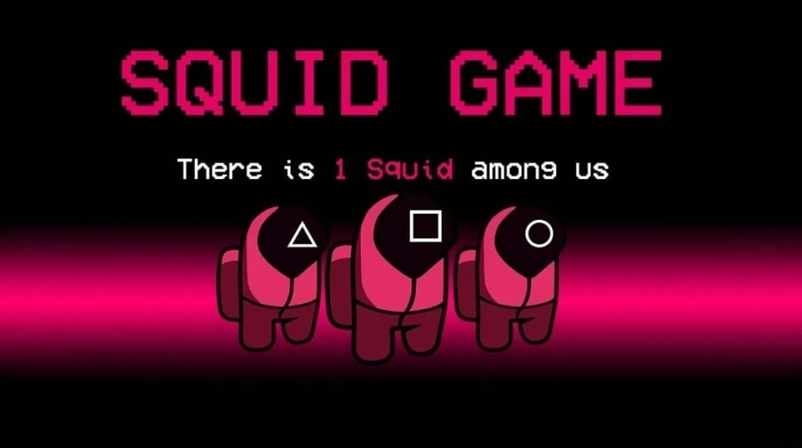
Be mindful of impostors ඞ
It is also well known that investors trust the opinions of eminent personalities. Swindlers often create fake videos starring such prominent faces and mislead investors with false information. In such cases, delving deeper often helps.
Investors should trace information to its source to verify its credibility.

Slide 11
Watch out for promises of high returns in little time
Every investor should bear in mind any investment needs time to grow in value. Moreover, volatile cryptocurrencies that display extreme price swings do exist.
Scammers use such traits to their advantage and promise surreal returns within short spans of time.
Phishing emails and social media handles are typically used by fraudsters to entrap gullible first–time investors.

Slide 12
Keep an eye on the URLs:
Most cases of fraud involve unsafe websites. If a ‘lock icon’ does not appear in the address bar next to the website, it is unsafe to be on that site.
Moreover, also check if the URL uses ‘https’ and not ‘http’ as the latter is unsecured. Phony site URLs, for example, may use the letter ‘O’ and the number ‘0’ interchangeably as the difference is difficult to spot.
Vigilance is the key to avoid getting defrauded.

Slide 13
Thank You

